Slide 1














Project Milestone Adult Income
Presented by Yuzal

Slide 2
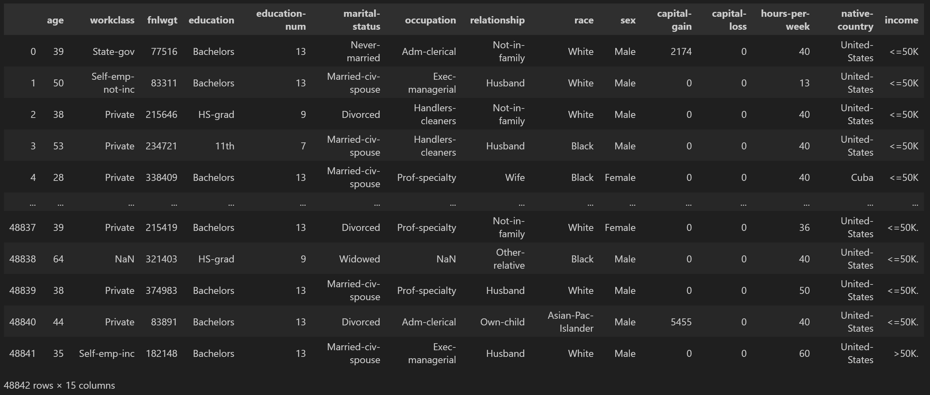
Datasets
Adult Income

Slide 3
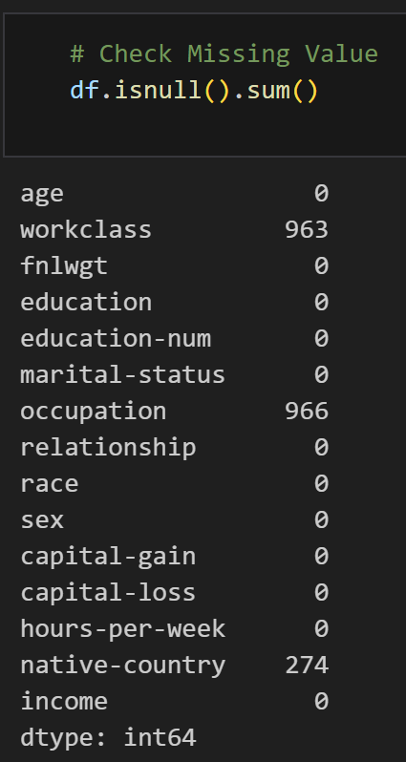
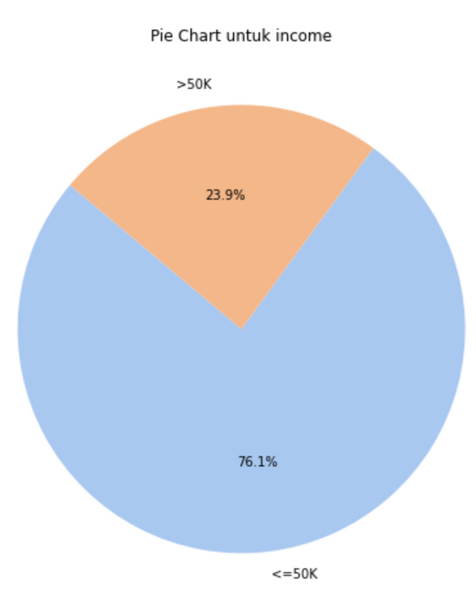
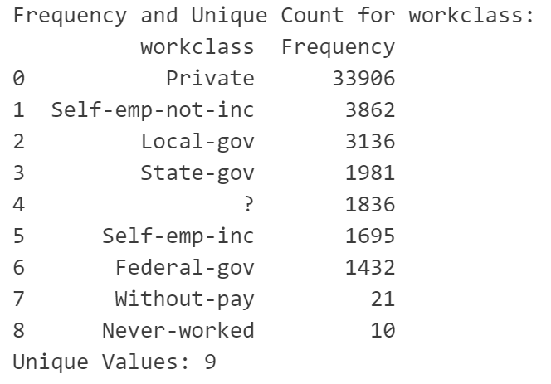
EDA SUMMARY
Missing Value
Pie Chart Target
Unique Value

Slide 4
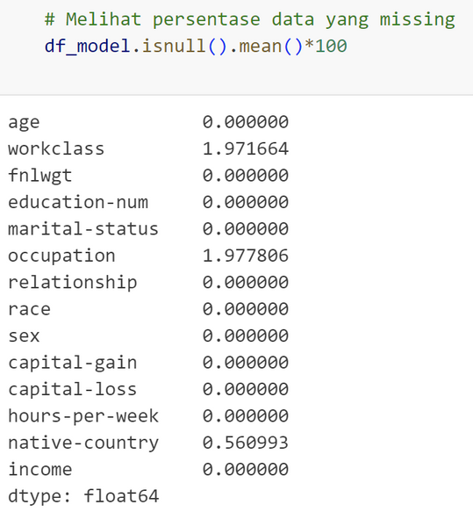
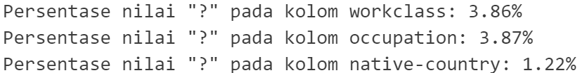
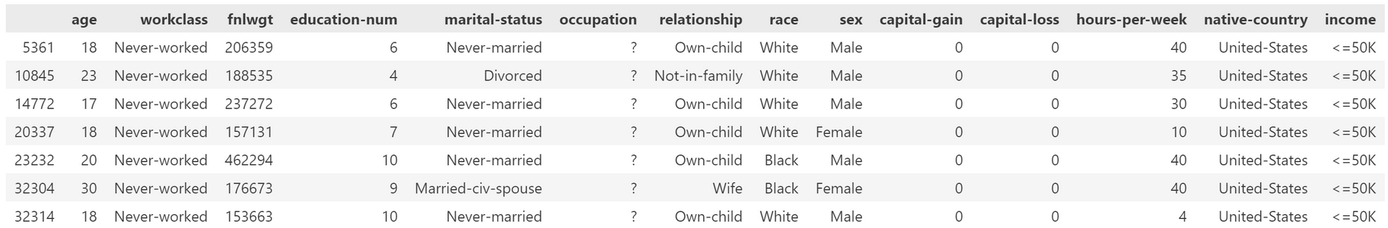
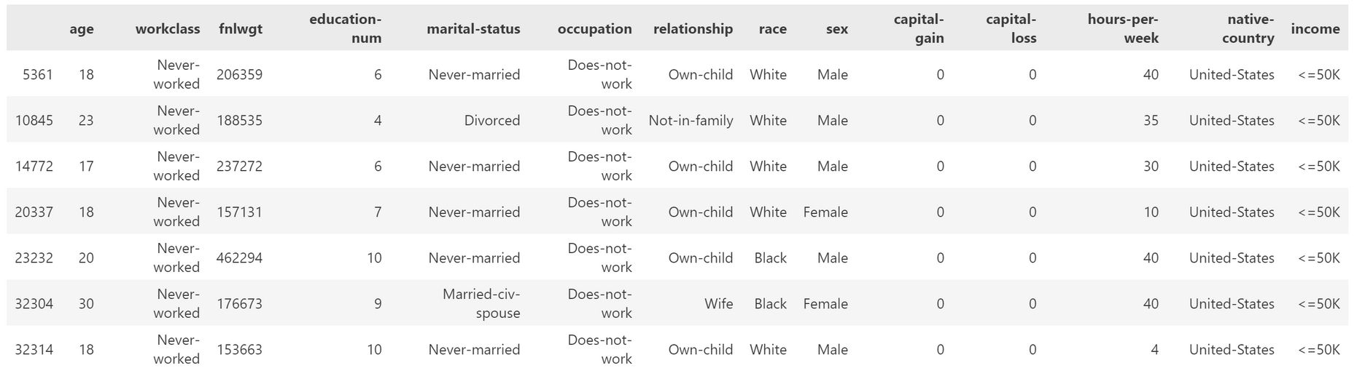
FE SUMMARY
Missing Value
Unique Value

Slide 5
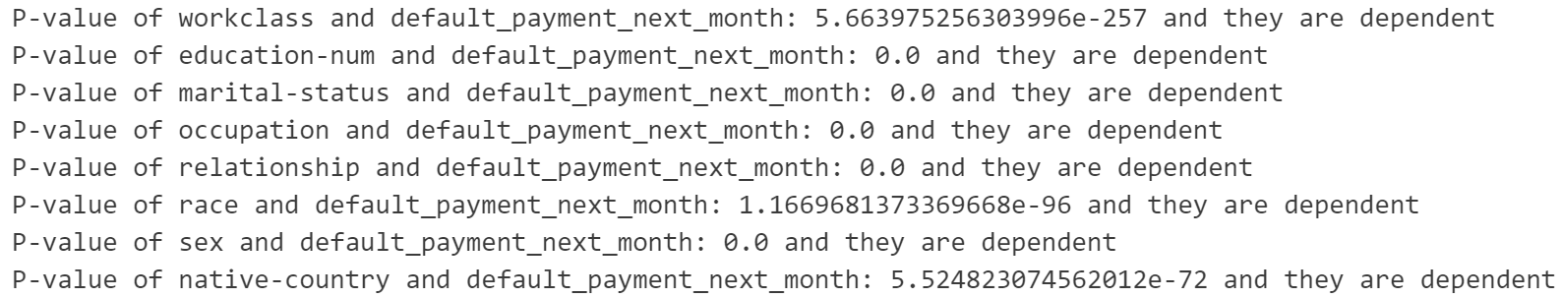
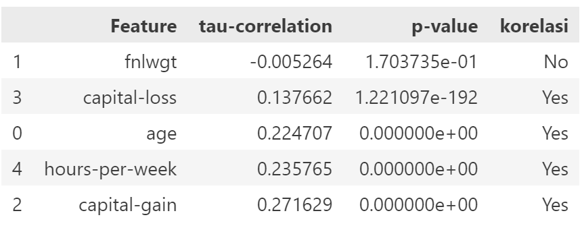
FE SUMMARY
Uji Korelasi Kategorikal
Uji Korelasi Numerikal

Slide 6
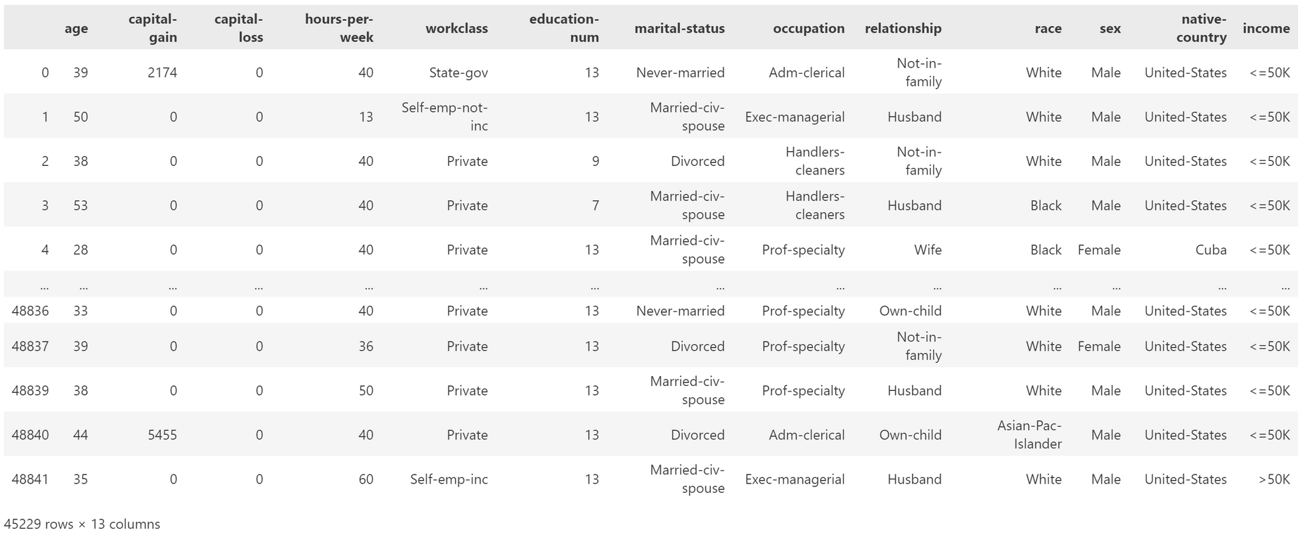
FE SUMMARY
Model Coloumn

Slide 7
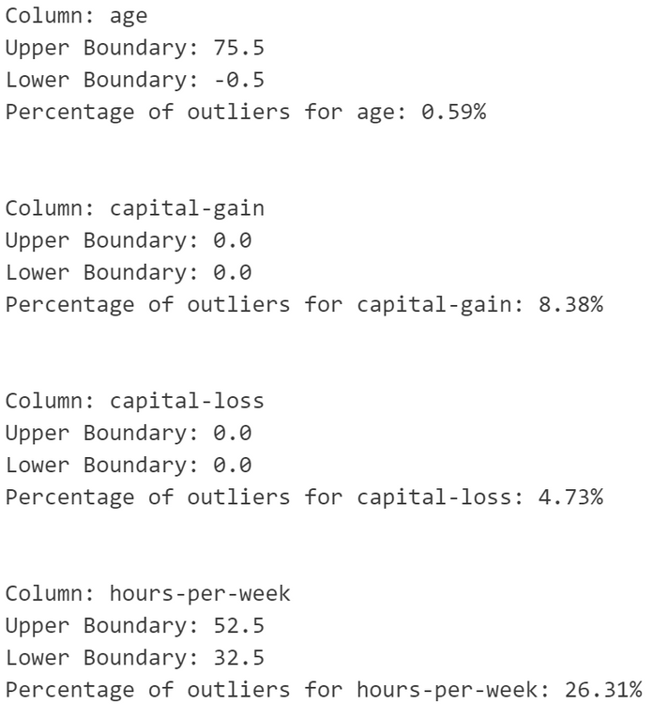
FE SUMMARY
Outliers

Slide 8
BASE MODEL
In this evaluation, I looked at the F1-score metrics because I want to assess the balance of the data to ensure that the model can make accurate predictions.
KNN
Train Set: F1-score = 0.87 (weighted avg)
Test Set: F1-score = 0.82 (weighted avg)
SVM
Train Set: F1-score = 0.82 (weighted avg)
Test Set: F1-score = 0.82 (weighted avg)
DecisionTree
Train Set: F1-score = 0.97 (weighted avg)
Test Set: F1-score = 0.82 (weighted avg)
RandomForest
Train Set: F1-score = 0.97 (weighted avg)
Test Set: F1-score = 0.84 (weighted avg)
XGBoost
Train Set: F1-score = 0.88 (weighted avg)
Test Set: F1-score = 0.87 (weighted avg)
From the data, it was found that the most balanced model is XGBoost.

Slide 9
CROSS VALIDATION
KNN Cross-Validation Scores: [0.81918618 0.81912186 0.81087413 0.81510085 0.81054864]
KNN Mean CV Score: 0.8149663328740056
SVM Cross-Validation Scores: [0.81465953 0.81606345 0.82054687 0.81167539 0.81633779]
SVM Mean CV Score: 0.8158566050698262
DecisionTree Cross-Validation Scores: [0.81630473 0.82167481 0.81723508 0.81297587 0.80822986]
DecisionTree Mean CV Score: 0.8152840715548866
RandomForest Cross-Validation Scores: [0.84591745 0.84194829 0.84132376 0.84347707 0.83458533]
RandomForest Mean CV Score: 0.8414503822064369
XGBoost Cross-Validation Scores: [0.87118836 0.86336746 0.86094369 0.86530593 0.86333504]
XGBoost Mean CV Score: 0.8648280968382289
XGBoost: The Mean CV Score is 0.8648. This indicates that XGBoost has the best performance among all the models tested, with the highest and most consistent f1-score.

Slide 10
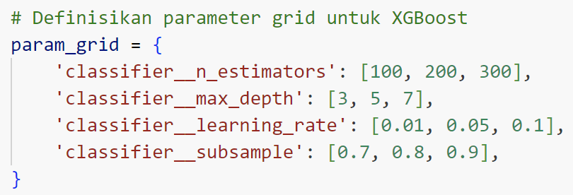
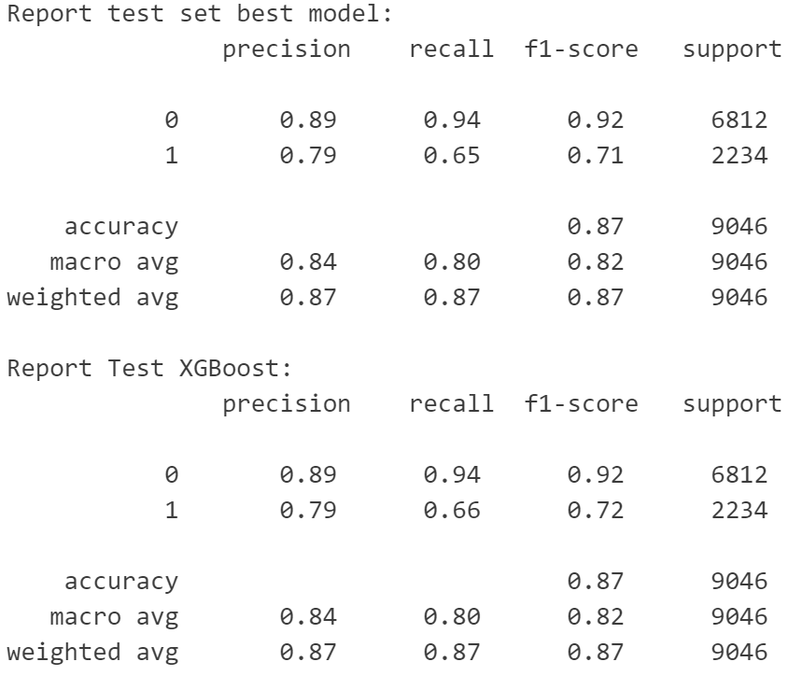
Hyperparameter Tuning
Fitting 5 folds for each of 81 candidates, totalling 405 fits
Best parameters: {'classifier__learning_rate': 0.05, 'classifier__max_depth': 7, 'classifier__n_estimators': 300, 'classifier__subsample': 0.9}
Best cross-validation score: 0.8670890495317117
After hyperparameter tuning, the cross-validation score increased from 0.8648280968382289 to 0.8670890495317117. Although the increase is only 0.003, it can be said that the model's performance has improved.

Slide 11
CONCLUSION
- After implementing the base model, it was found that the XGBoost model is the best with a balanced f1 score.
- XGBoost, after hyperparameter tuning, increased by only 0.003 from the base model.
- From a business perspective, this model can be used to help government agencies understand the income of their citizens based on job, marital status, education, and other factors.
- However, this model has a relatively high f1-score accuracy for values below 50k with a percentage of 90%, and for values above 50k, it has a percentage of 70%.
- This model requires improvement to enhance prediction results so that the percentage difference is minimized. Techniques such as resampling, using more complex models, or additional feature engineering can be applied.

Slide 12
Thank you very much!

